Slide 1
Establishing a SOLID Foundation An Intro To Software Design
Cameron Presley
@pcameronpresley
http://blog.thesoftwarementor.com

Slide 2
Little About Myself
Software Engineer from Knoxville, TN
Senior Software Engineer at Pilot/Flying J
“Developer Betterer”
Co-Founder of @FunctionalKnox

Slide 3
Outline
What is SOLID?
Why should our code be SOLID?
Exploring the SOLID principles
Additional Resources

Slide 4
What is SOLID?
Mnemonic for a set of principles that allows us to write easier to maintain code
Concepts aren’t new (late 80’s)
Introduced by Robert C. Martin (Uncle Bob) in Agile Principles, Patterns, and Practices

Slide 5
What is SOLID?
Single Responsibility
Open/Closed
Liskov Substitution
Interface Segregation
Dependency Inversion

Slide 6
Doing Too Much
Bad Abstractions
Notes:
What is SOLID really?
It’s these two concepts
See it all the time (junior developers to seniors)

Slide 7
Why Should We Write SOLID Code?

Slide 8
Reading vs Writing
Notes:
Where do we spend the majority of our time? Reading or writing code?
Has typing speed ever been a limitation?

Slide 9
Overdesign is the root cause of issues
Notes:
However, we need to make sure that our code is readable, but also not-over engineered
Home many of you have seen “Enterprise” FizzBuzz? That’s a great example of over-engineering

Slide 10
Time-to-Context
Notes:
How many of you have seen an architecture and had to spend a good amount of time understanding it?
The concept of reading for 20 minutes and then making a single line change.
The time to understand what you’re seeing to taking actions is called “Time-to-context”

Slide 11
Who Maintains The Code Once You Leave?
Notes:
You’re not always going to be maintaining your code?
Typical developer changes jobs every 2-3 years
Want to pick a style that developers can pick up on quickly

Slide 12
Optimize for time-to-context

Slide 13
What are signs of SOLID Code?

Slide 14
Many small classes composed into larger classes

Slide 15
Easy to test

Slide 16
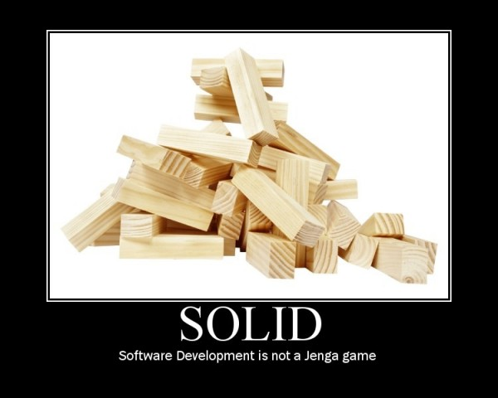
Exploring the SOLID Principles

Slide 17
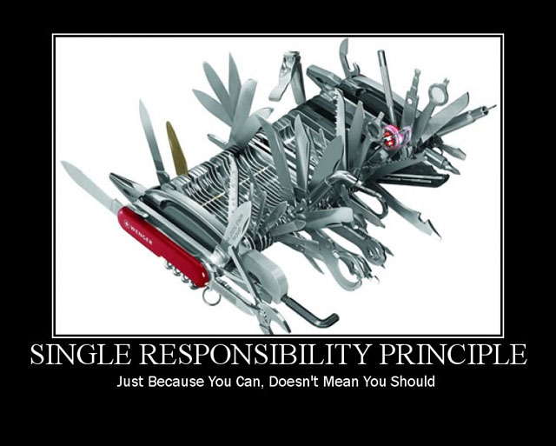
Single Responsibility Principle

Slide 18
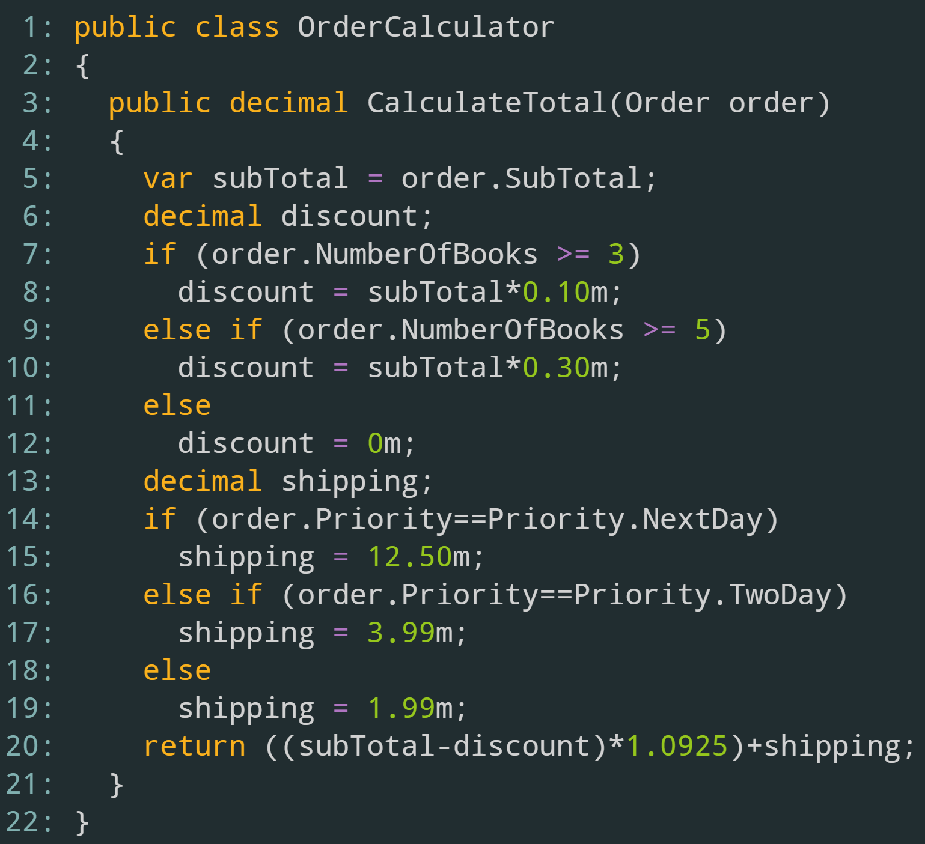
Notes:
Writing a bookstore application
Here’s code that calculates the total for an order
Quickly, what is it doing?
Figuring out the subtotal, discount, and shipping, and then doing some math
Total = (subtotal-discount)*salesTax + shipping
It’s takes some time to parse through the details.
Why not improve this for readability?

Slide 19
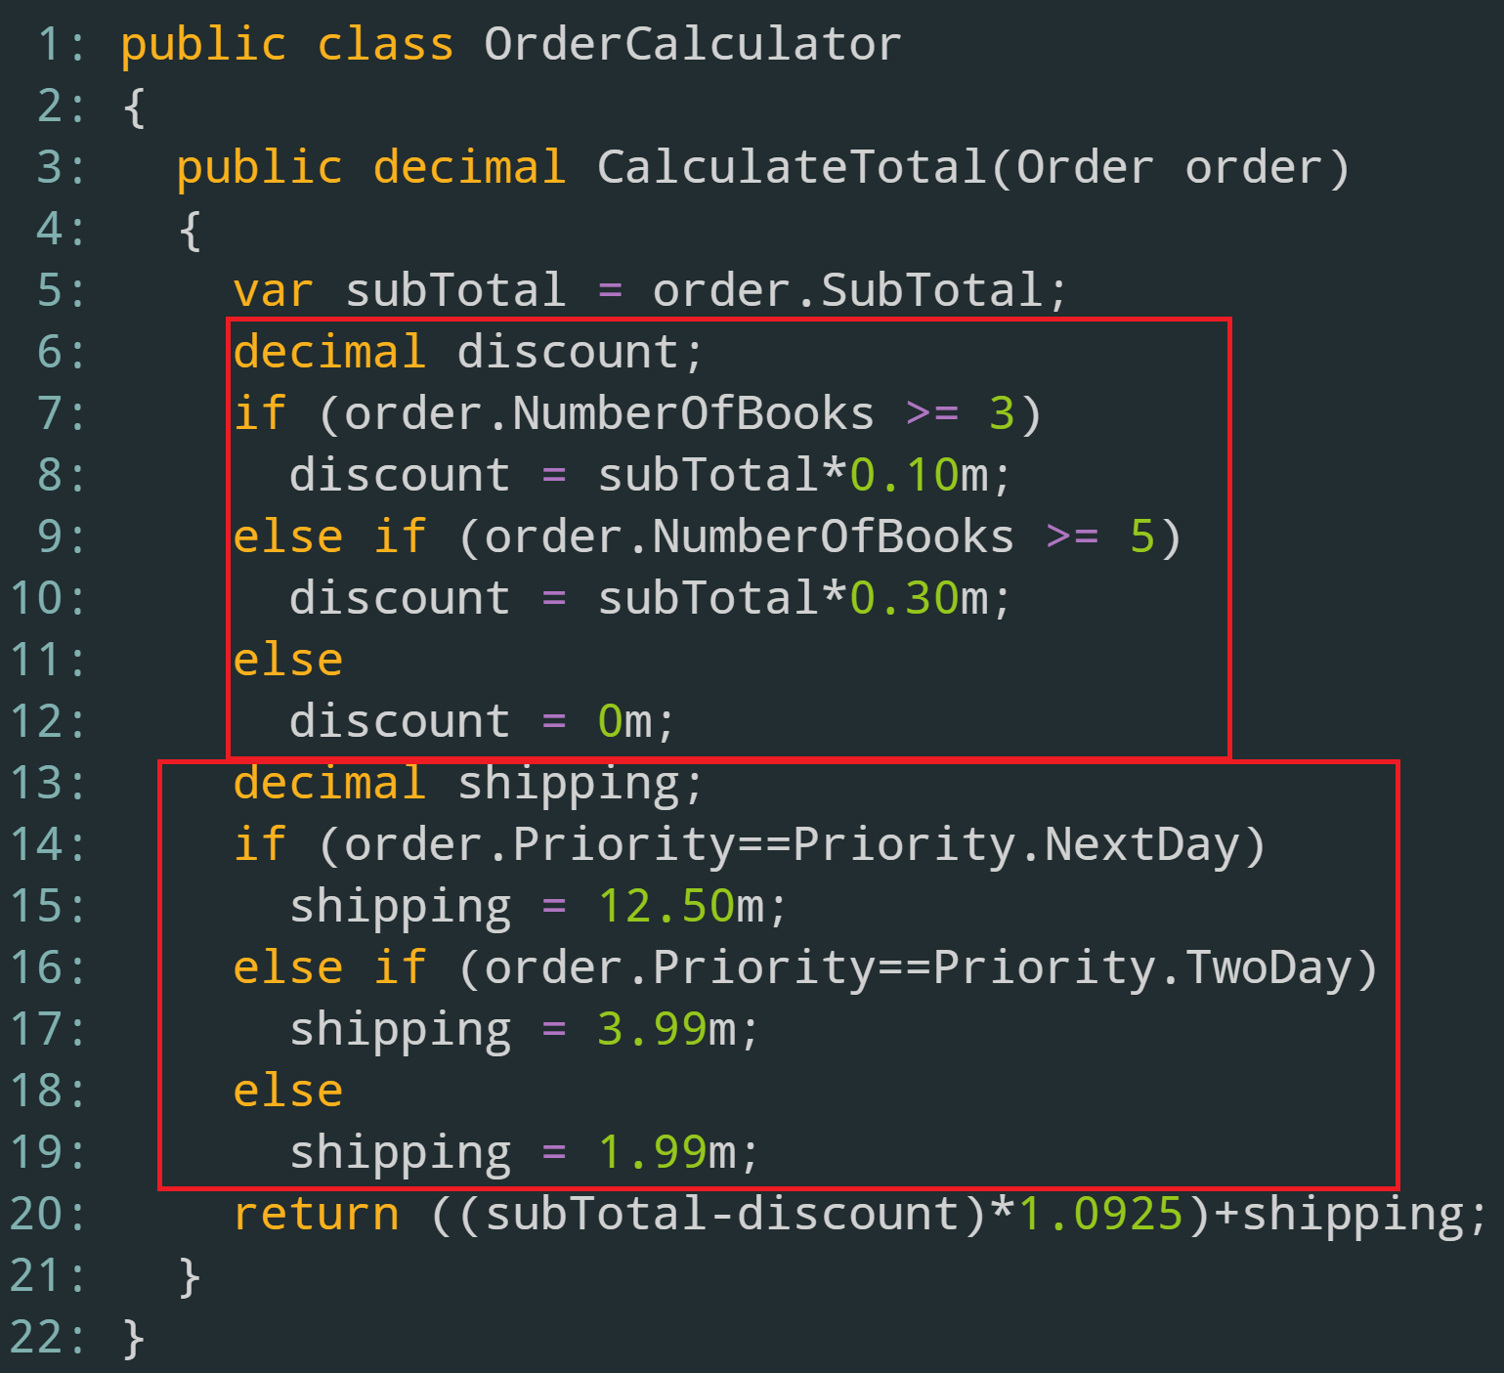
Notes:
Each block is doing a piece of work (figuring out the discount or shipping cost)
Let’s extract these to private methods

Slide 20
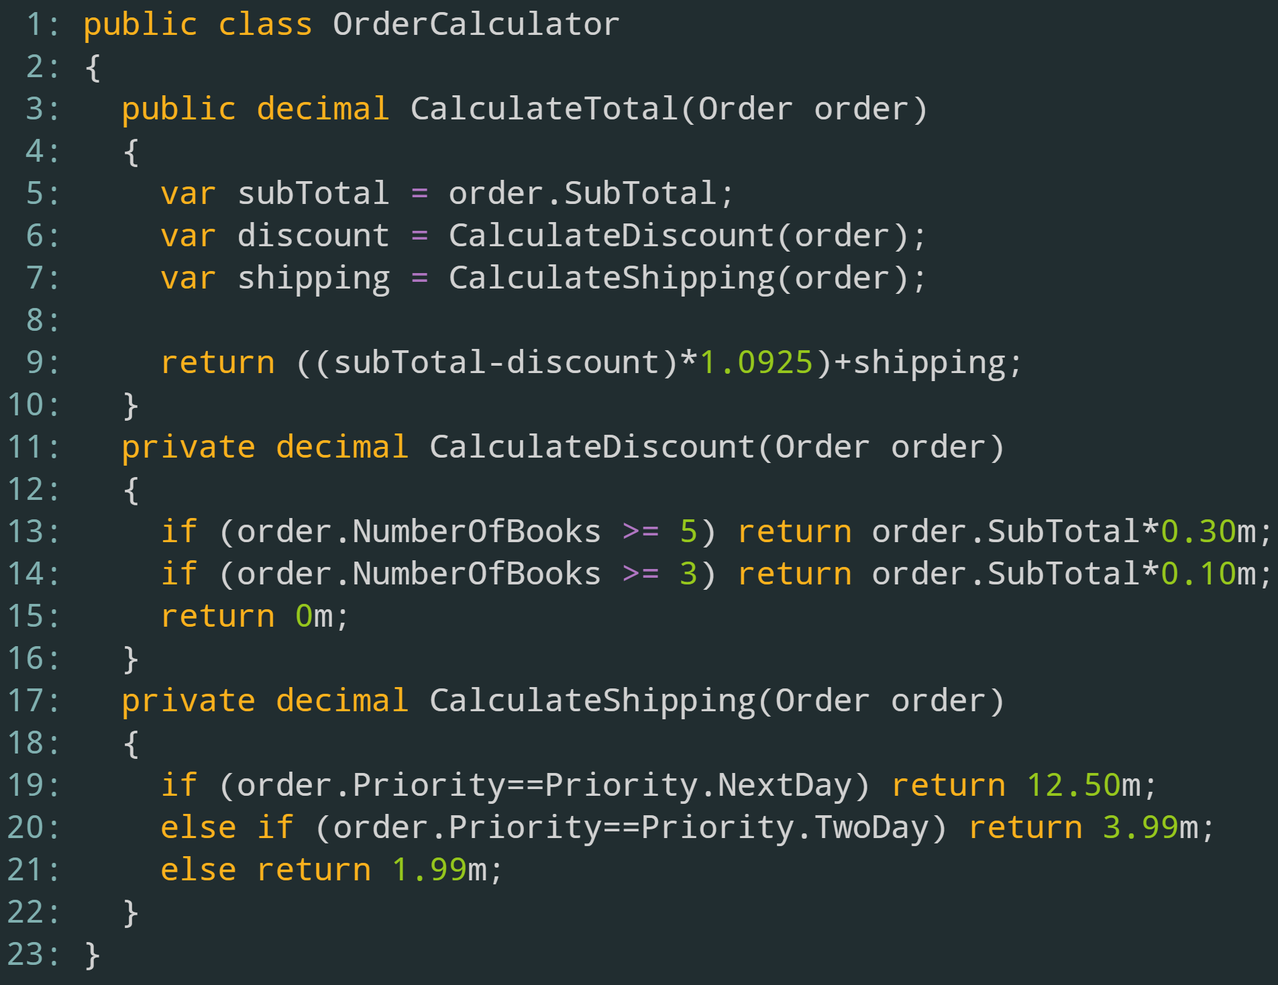
Notes:
This is already loads better than what we had before.
However, writing tests for this class can be a bit hard.
We’d have to come up with a pre-baked order and send it here
(i.e. If I have this particular order, I expect this total)
However, if it fails, we don’t know immediately why
- Was it the discount logic or the shipping logic?
We can extract the private methods to new classes and can unit test those (i.e. for this order, I’d expect this much of a discount, for this order, I’d expect this much of shipping)

Slide 21
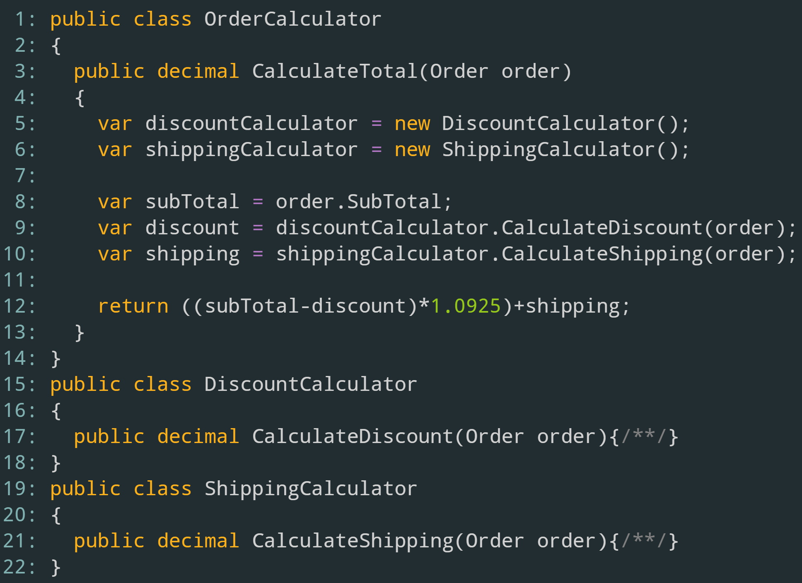
Notes:
This solution does add a bit of complexity (i.e. new classes), but at the cost of delegating the work correctly
If we introduce a bug into the DiscountCalculator, our tests on the DiscountCalculator will fail, not tests on the OrderCalculator

Slide 22
A class should have one reason to change

Slide 23
Why It’s a Problem
Large classes are hard to test and to maintain
If multiple developers need to work on the class at the same time…

Slide 24
How to Spot
Classes can be measured in hundreds (or thousands) of LOCS

Slide 25
How to Spot
27 public methods

Slide 26
How to Spot
Single public method with 54 private methods

Slide 27


Slide 28
How to Fix
Break large methods down into smaller methods
Move private methods to new classes
Instantiate and use the new classes

Slide 29
Single Responsibility Principle Summary
Classes should only have one reason to change
By breaking classes down into smaller pieces, it allows us to work on the separate pieces of functionality
Combine just-what-we need functionality into new classes

Slide 30
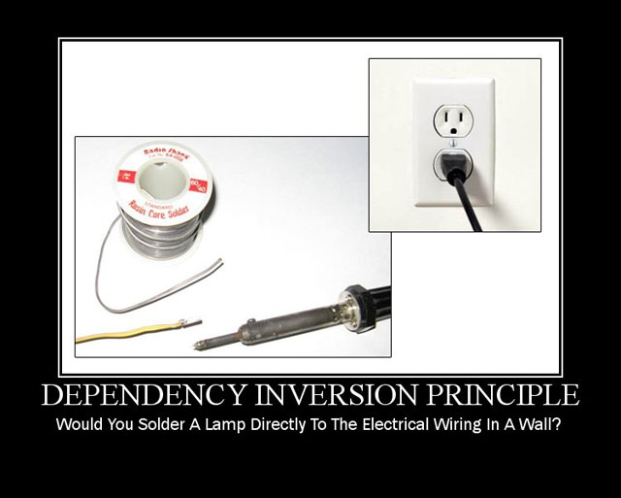
Dependency Inversion Principle

Slide 31
Dependency Inversion Principle
Classes should depend upon abstractions
Classes shouldn’t be responsible for creating their own dependencies

Slide 32
Why it’s a problem
Only way to change dependencies is to change the class
Impossible to write unit tests that cross system boundaries
Provides another way to determine if a class is doing too much (32 dependencies)

Slide 33
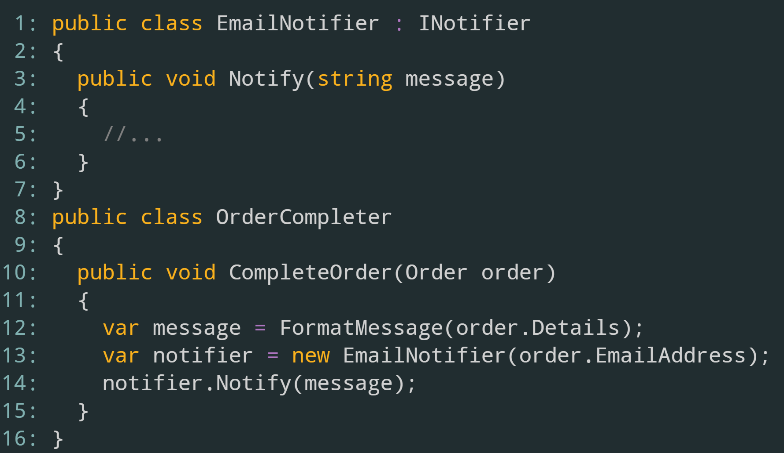
Notes:
Added some functionality to send email when order is completed

Slide 34
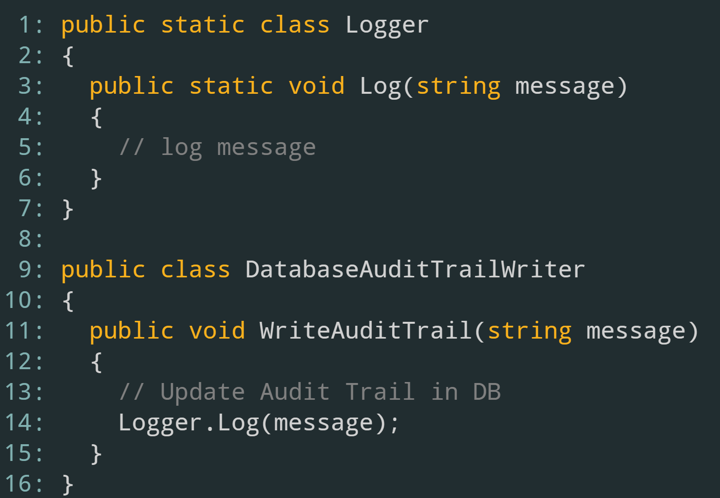

Slide 35
How to Fix
Two goals
Make sure the dependency can be passed in
Make sure the dependency has an abstraction
If the class is static, make it not static
If the class doesn’t have an interface, define one
Inject the dependency using constructor injection or method injection

Slide 36
Static Classes
Issues with static classes
Can’t pass them as parameters
Can’t implement an interface or base class
Removing the static attribute is ideal, but not always possible
Using the Wrapper pattern, we can define another class that is not static to wrap around the static and then pass that around

Slide 37
Working With Static Classes

Slide 38
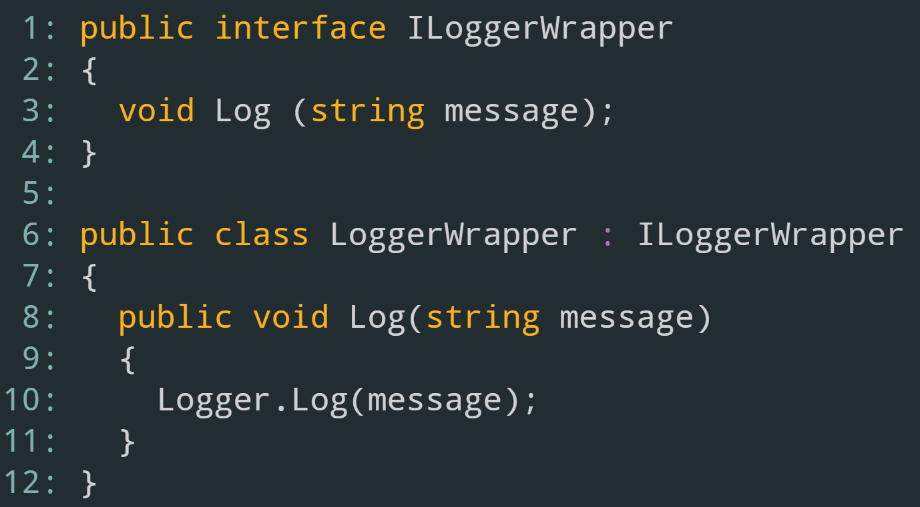
Introducing the Wrapper

Slide 39
Passing Dependencies
Constructor vs Method Injection
“Will this dependency need to change during the object’s lifetime?”

Slide 40
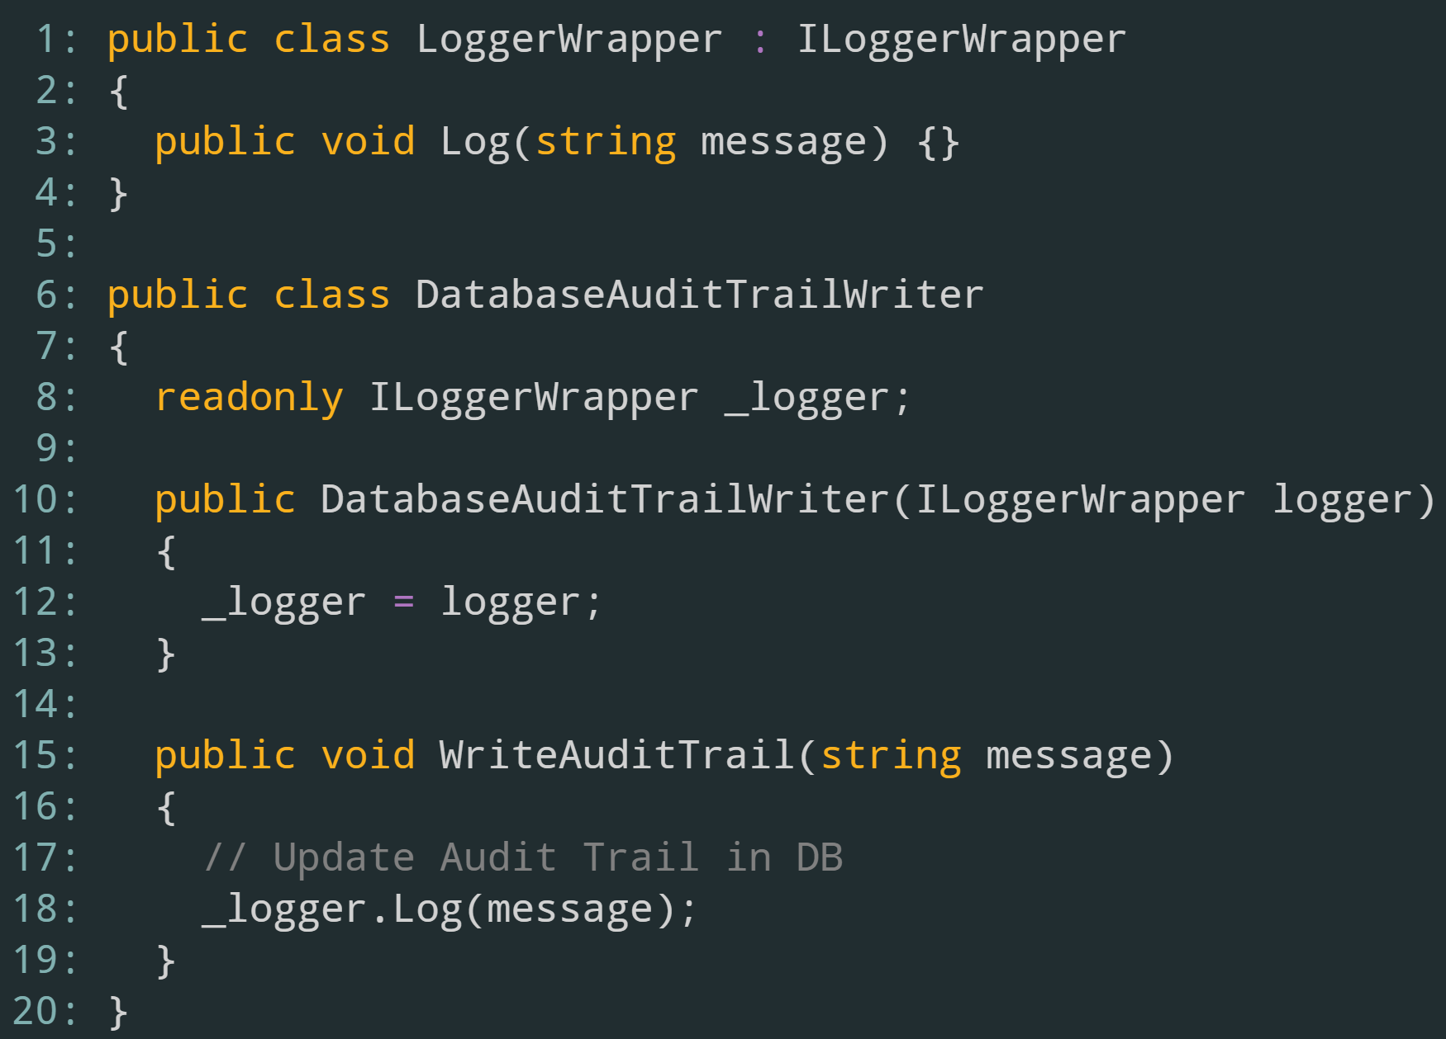
Passing Dependencies

Slide 41
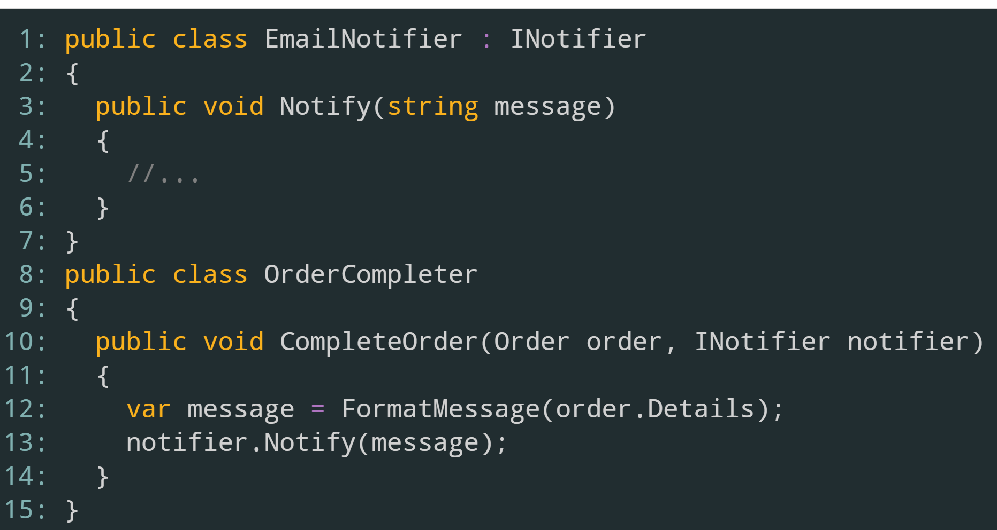
Passing Dependencies

Slide 42
Dependency Inversion Principle Summary
Classes should depend upon abstractions
Allows us to switch dependencies at runtime
Useful for testing
Use the Wrapper pattern to handle static classes
Use method injection or constructor injection for passing dependencies

Slide 43
Writing SOLID Code
80% of issues with these two principles
The remaining principles cover the additional 20%

Slide 44
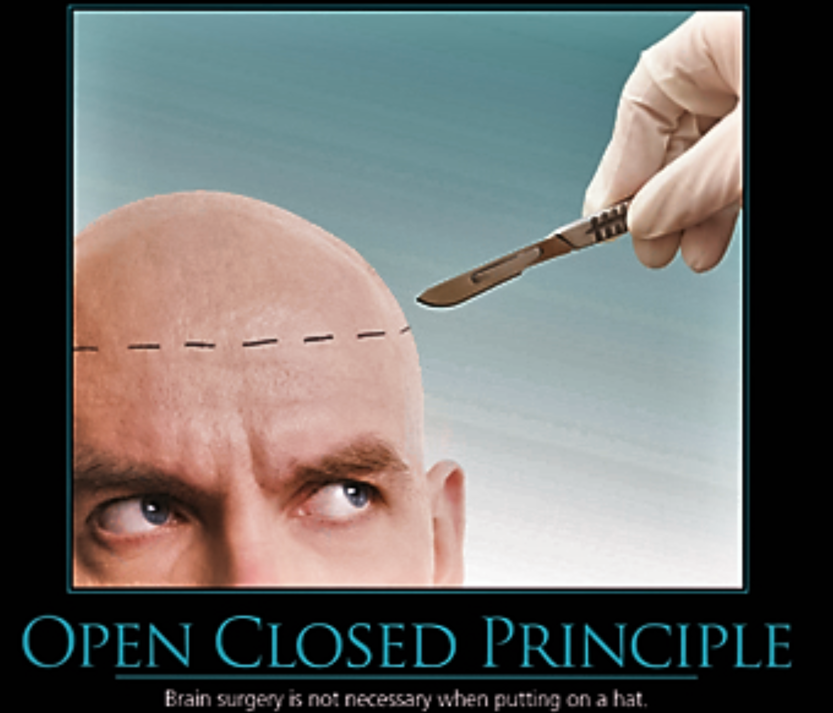
Open/Closed Principle

Slide 45
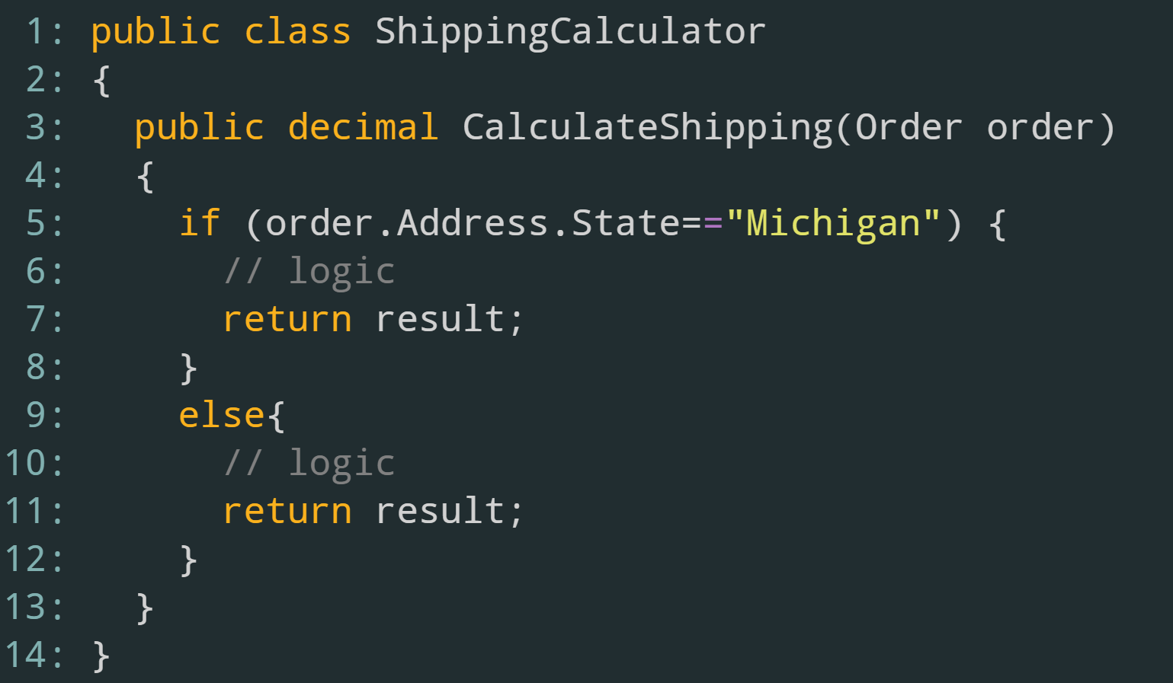
Calculating Shipping Costs

Slide 46
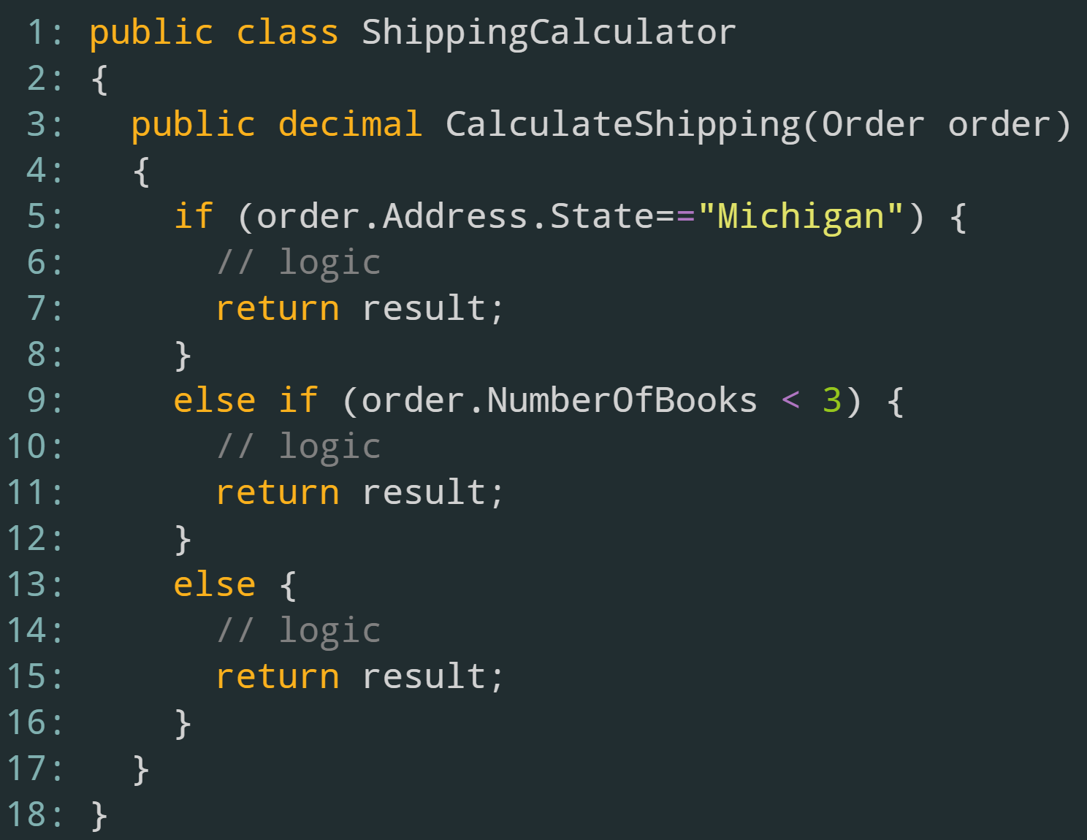
Adding a new rule

Slide 47
Open/Closed Principle
Classes should be open for extension, closed for modification
Means that we should add new functionality by adding new classes, not modifying existing ones
NOTE: Doesn’t mean that we can’t modify a class to fix bugs

Slide 48
Why it’s a problem
If we modify a class to add additional functionality, it’s hard to make sure that we didn’t break something downstream
OCP forces us to add functionality by creating new classes and then using an abstraction
Easier to create a new class and use it then to modify an existing one and make sure we didn’t break anything

Slide 49
How to Fix
Refactor to Factory Pattern
Each logic branch is a class
Original class becomes the Factory that returns a concrete class
Update clients to use the Factory instead

Slide 50
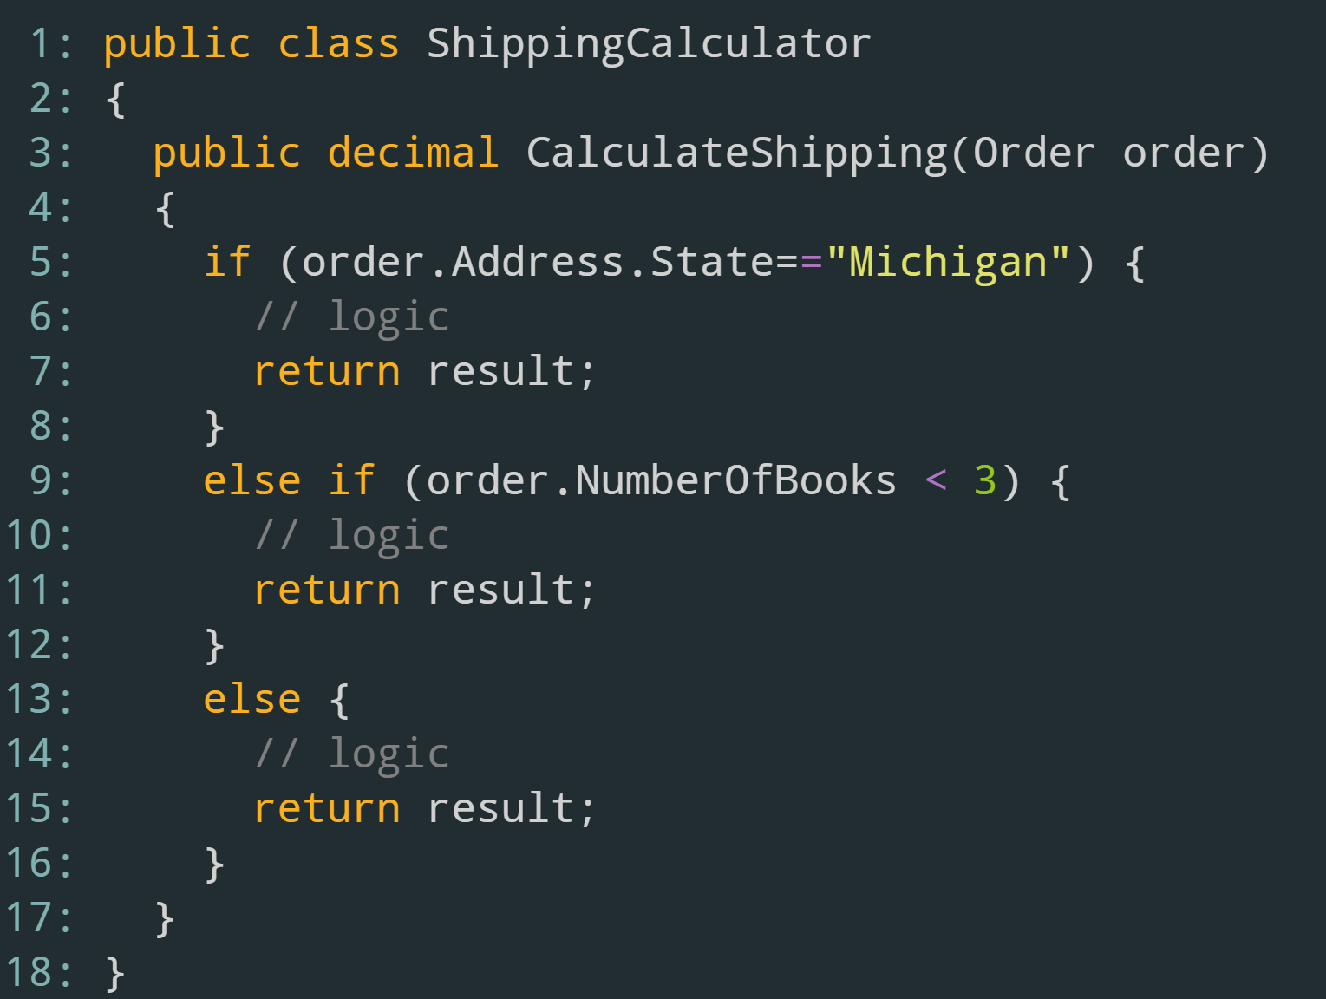
Notes:
Using SRP, we can extract the logic to functions, then classes
Using DIP, we’ll provide an abstraction to use

Slide 51
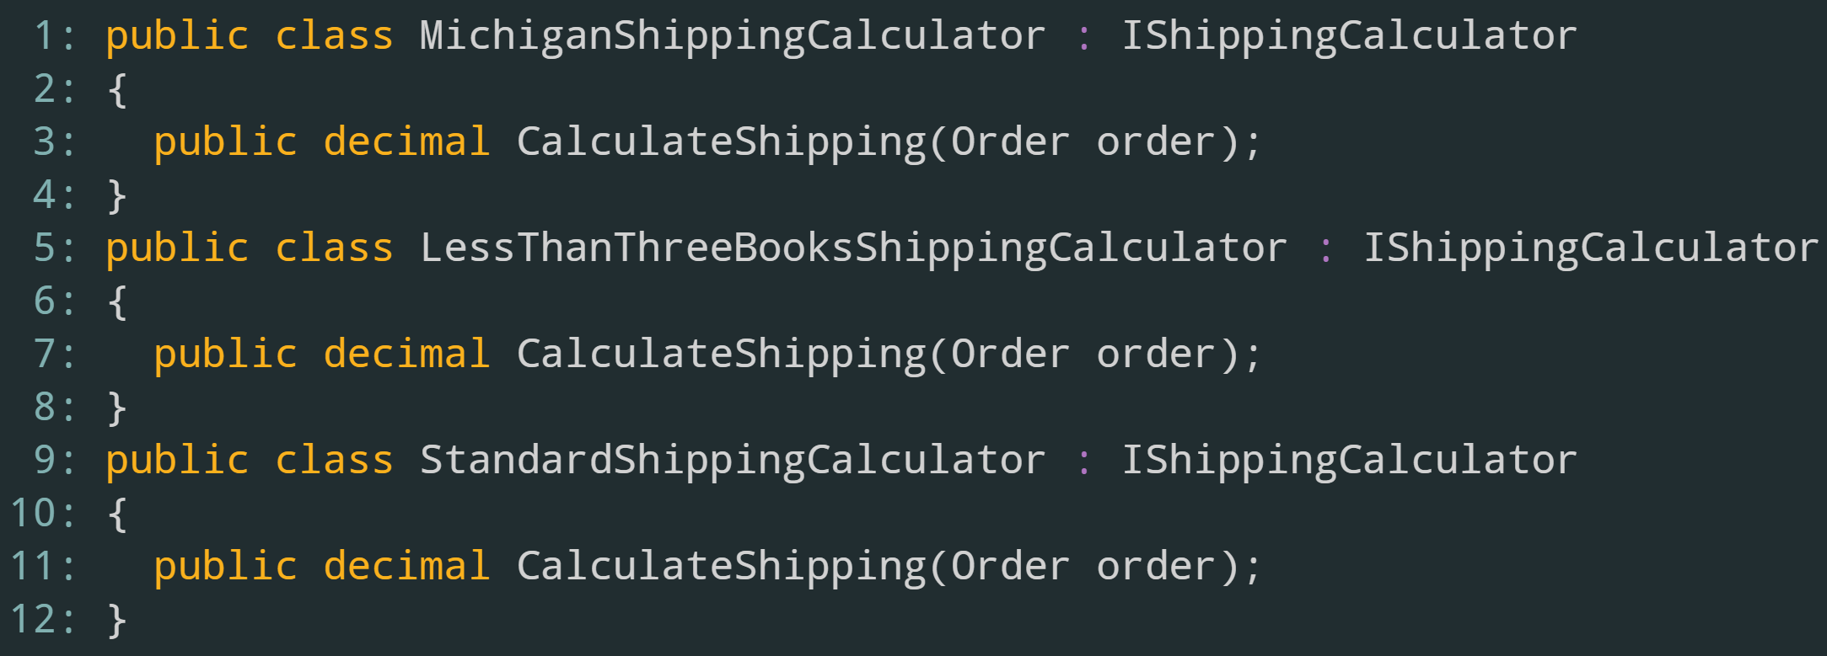

Slide 52
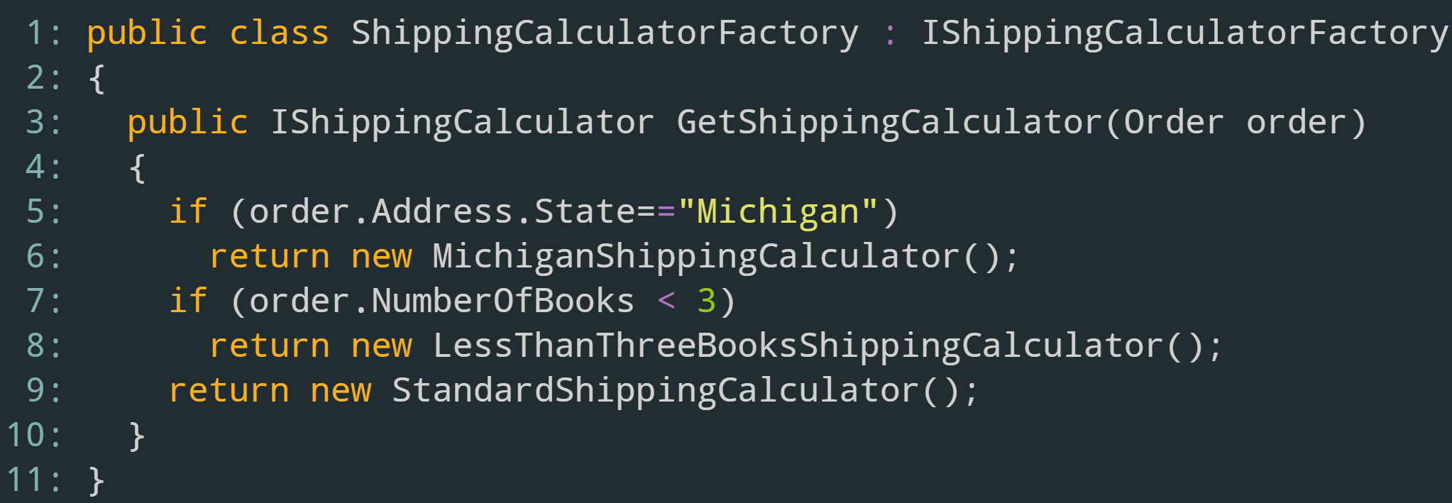
Notes:
Since the type of ShippingCalculator can change, we can introduce the Factory pattern to determine which ShippingCalculator to return

Slide 53
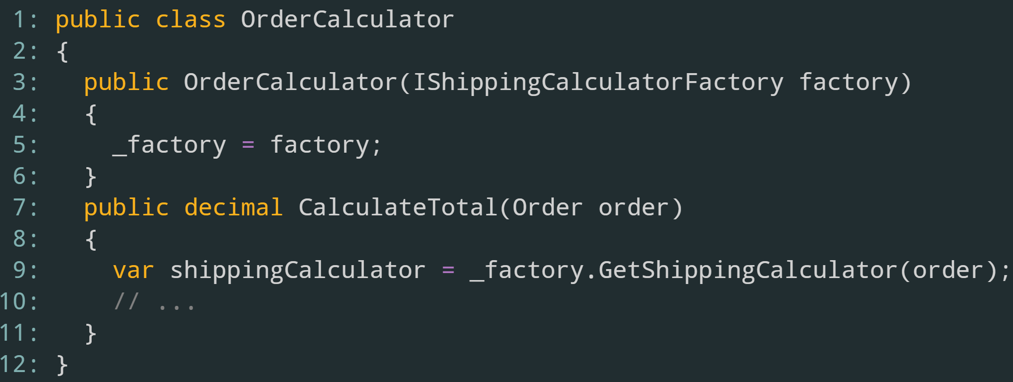
Notes:
Update OrderCalculator to use the shipping factory

Slide 54
Adding New Functionality
Need to add an additional calculator?
Create the class
Impelment IShippingCalculator interface
Implement business rules
Update the factory to return the correct calculator
Notice how we didn’t have to modify the OrderCalculator class to handle different calculators

Slide 55
Open/Closed Principle Summary
Classes should be open for extension, closed for modification
By introducing abstractions, we can easily extend our application without worrying about breaking something downstream
Allows us to add additional functionality by creating new classes, not modifying pre-existing ones

Slide 56
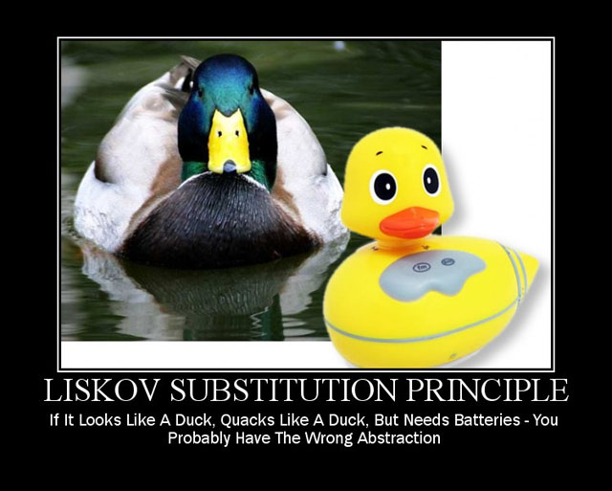
Liskov Substitution Principle

Slide 57
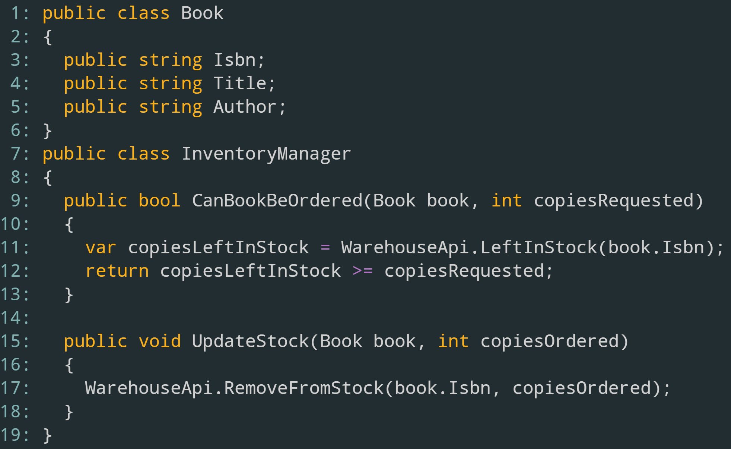

Slide 58
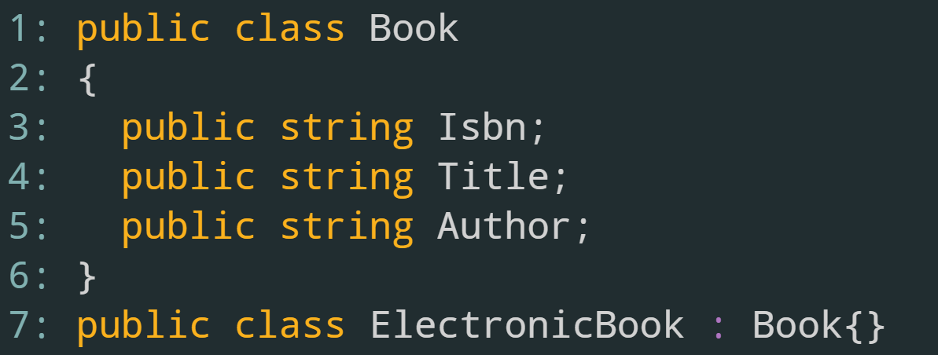
New Requirement - EBooks
Notes:
All ElectronicBooks are Books, right?

Slide 59
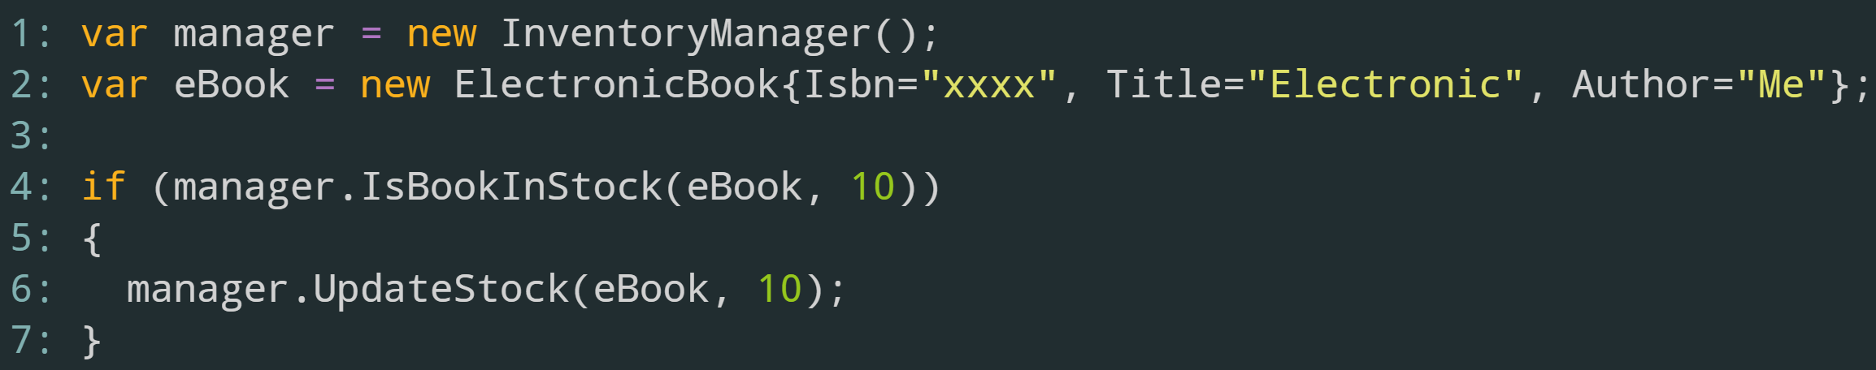
Notes:
Well, what about this code?
Our inventory manager shouldn’t work with EBooks

Slide 60
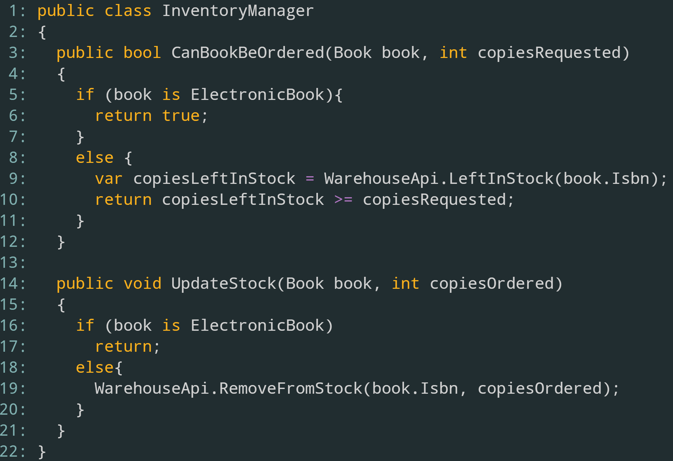

Slide 61
Type casting to perform logic is a bad abstraction
“Leaky Abstractions”
Can’t lean on the compiler for error finding

Slide 62
Not all Books are created equally
What if we changed our abstraction structure a bit?

Slide 63
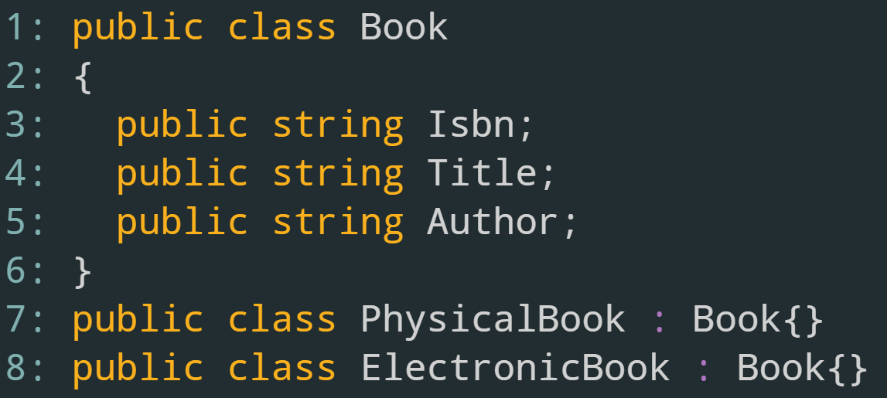

Slide 64
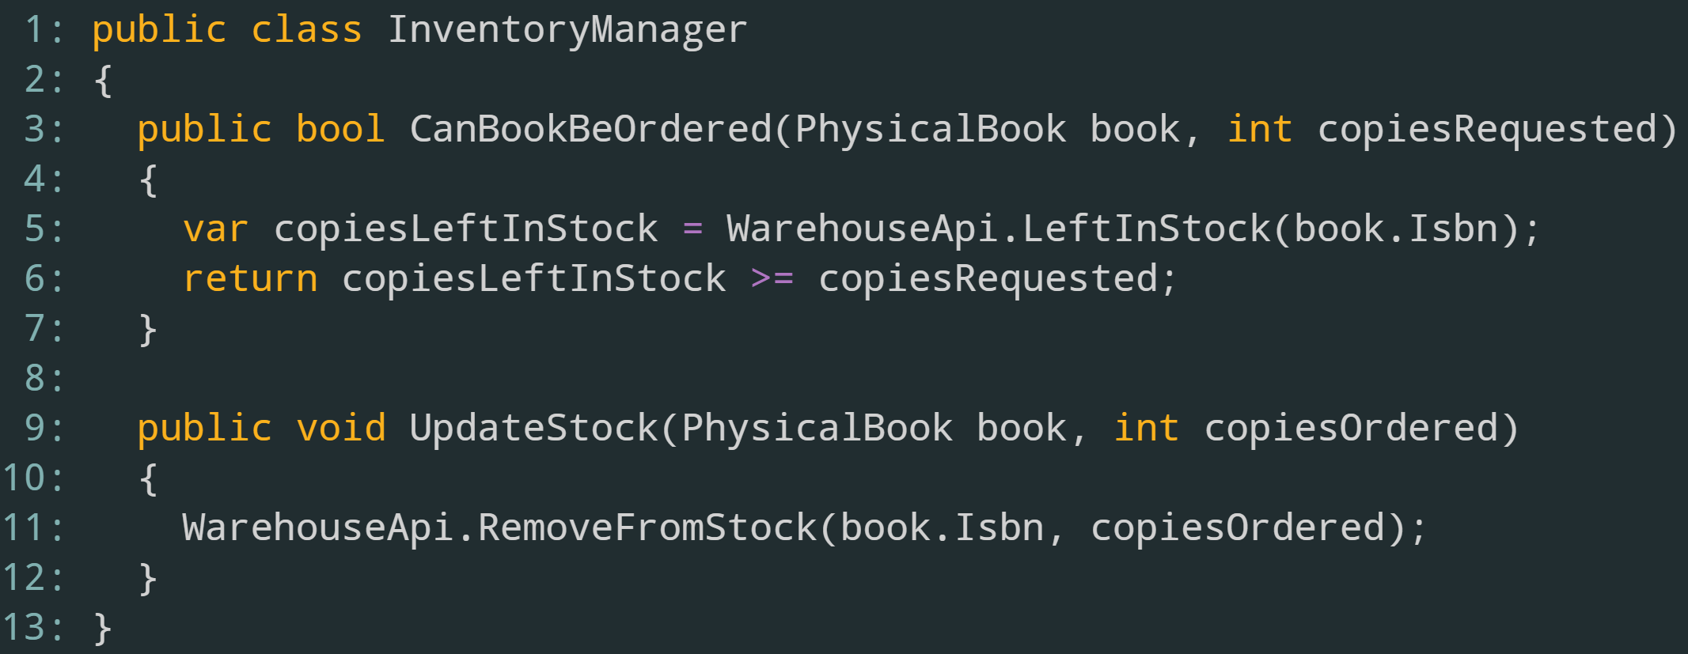

Slide 65
Liskov Substitution Principle
If two classes are derived from the same abstraction, then they should be interchangeable
Should not depend upon the class of the abstraction to do work

Slide 66
LSP – Problem It Solves
Abstractions hide implementation details
Special handling causes code to be more complex
No “leaky abstractions”

Slide 67
LSP – Resolving Violations
Some cases, the abstraction doesn’t make sense
Makes sense to find a better abstraction (not always possible)
If possible, move special logic to the offending class

Slide 68
Liskov Substitution Principle Summary
Two classes derived from the same abstraction should be interchangeable
Shouldn’t have to add special handling code in the client
If found, try to find a better abstraction or move offending logic to the specific class

Slide 69
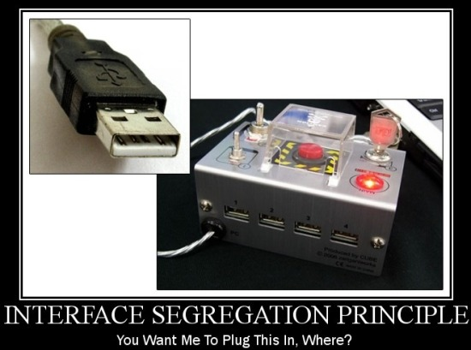
Interface Segregation Principle

Slide 70
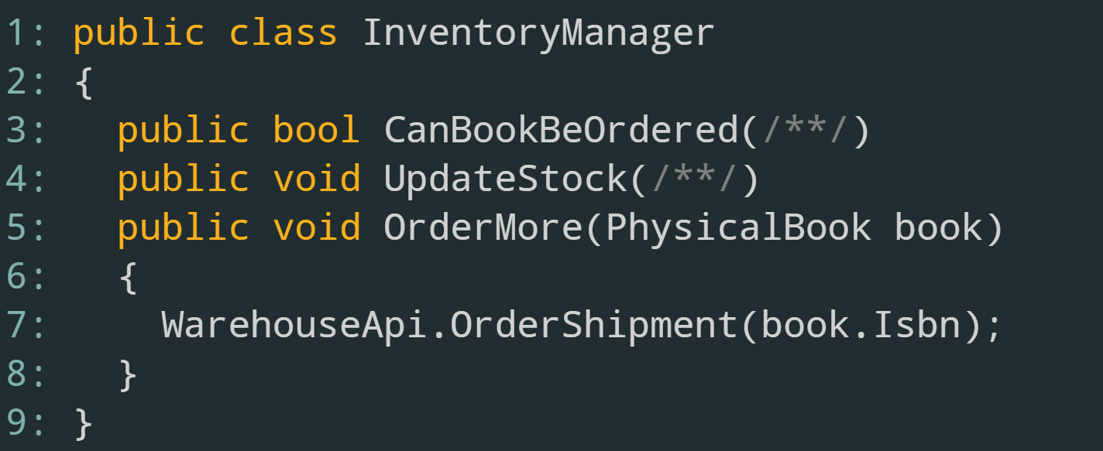

Slide 71
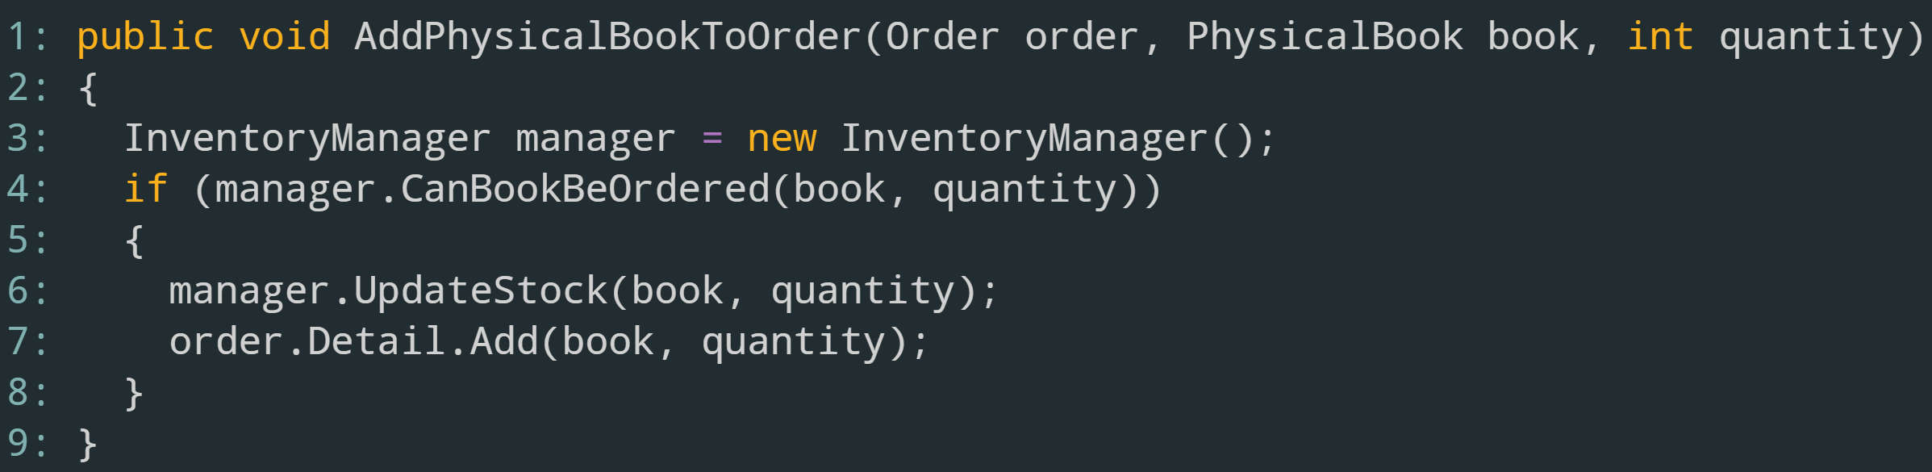
Adding Books to an Order

Slide 72
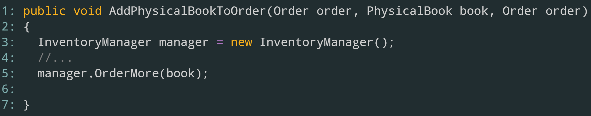
Problem?

Slide 73
Shape our abstraction to roles, not a list of everything it can do

Slide 74
One role is to track inventory when an order is made
Define an interface with the methods required
Have the InventoryManager class implement
Update client code to use the new interface

Slide 75
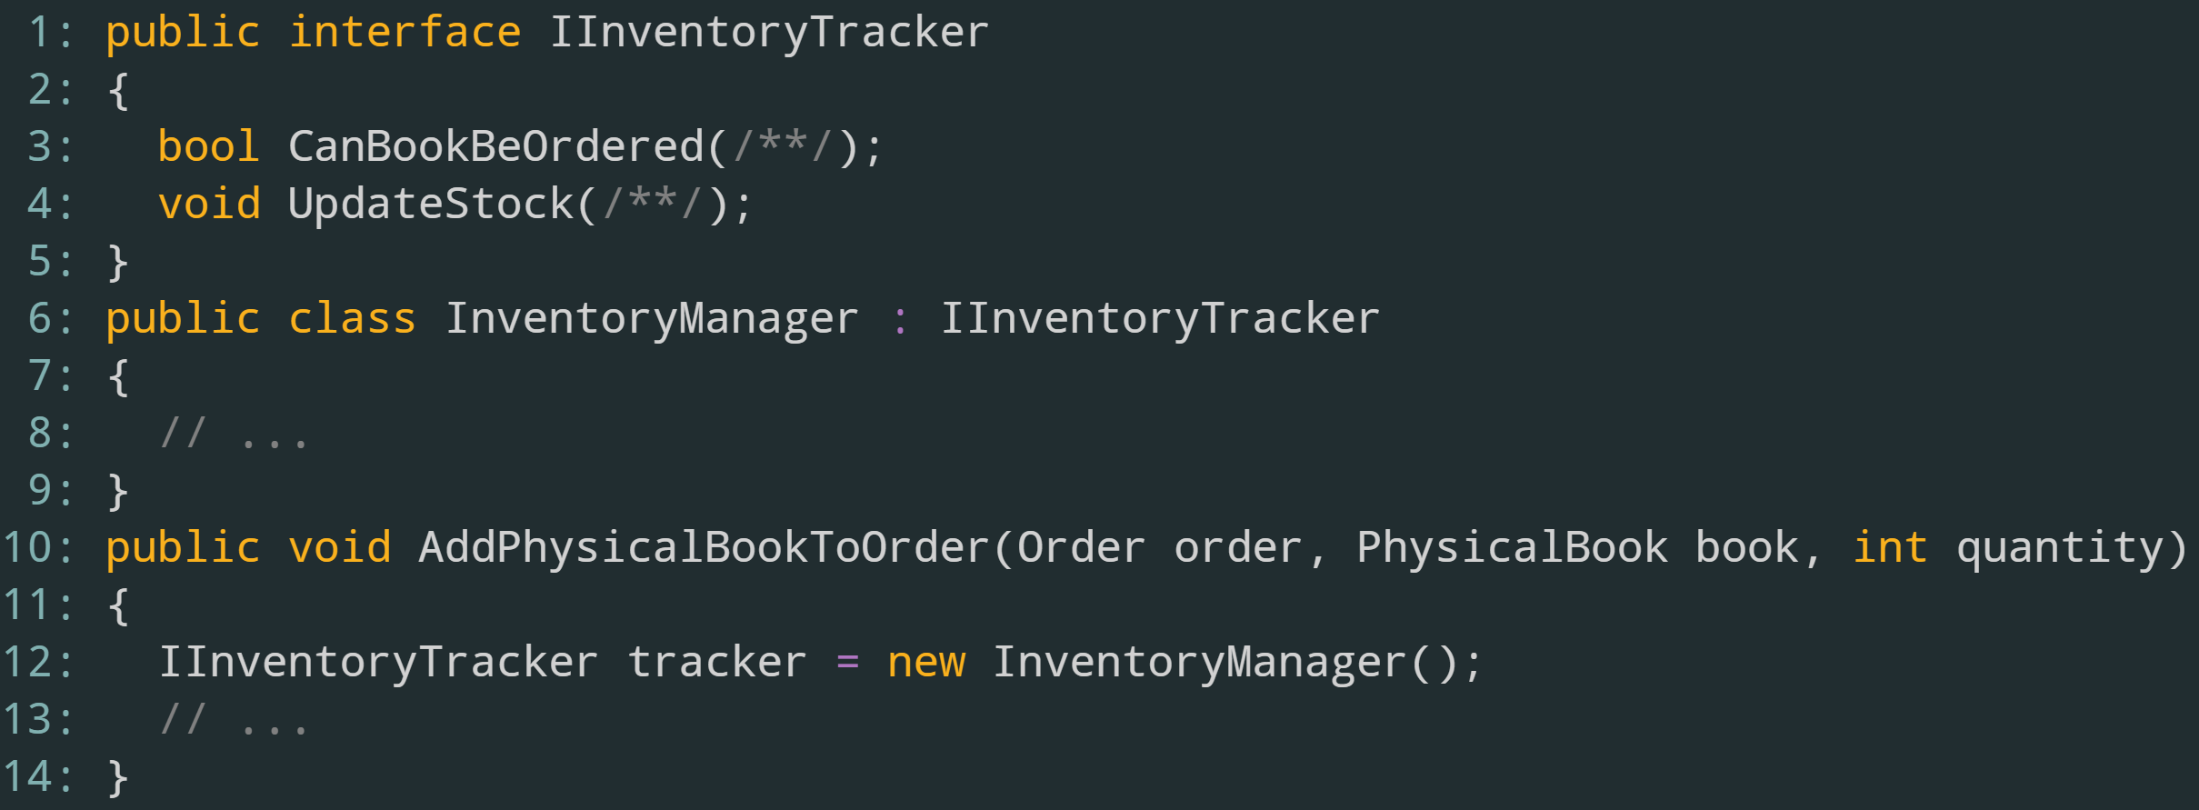

Slide 76
Interface Segregation Principle Summary
Clients should only have access to methods and properties that they need
Use role interfaces, not header interfaces
Similar to Single Responsibility, break down large interfaces into smaller ones and update the client accordingly

Slide 77
Summary
What is SOLID?
Why should our code be SOLID?
What the principles stand for
How to spot violations
How to fix them
Doing Too Much & Bad Abstractions

Slide 78
Resources
Books
Agile Principles, Patterns, and Practices by Robert C. Martin
Working Effectively With Legacy Code by Michael Feathers
Code Complete (2nd Edition) by Steve McConnell
Videos
SOLID Principles of Object Oriented Design by Steve Smith
Articles
Role Interfaces by Martin Fowler

